Slide 1

3D Printing of Magnetic
Multi-Material Hydrogels
IIB Project Midterm Presentation ~ Nanoscience Centre, Cambridge
Supervised by Yaqi Sheng and Shery Huang
By Lorcan Nicholls ~ ln356@cam.ac.uk
‹#›
Notes:
Hello, my name is Lorcan, I’m working in Shery’s group on 3D printing of magnetic multi-material hydrogels.

Slide 2






Presentation Outline
Introduction
Project Goals
Theory
Practical Methods
Results
Work To Do
Notes:
I’ll start by introducing some background and the motivations for the project, then talk about the goals and the project itself, and close by showing some of the results I’ve found so far as well as the work that’s left to do.

Slide 3
Introduction
What is the motivation for the project?
What’s in the literature so far?
Introduction
Project Goals
Theory
Procedures
Results
Work To Do
‹#›
Notes:
So some background for the project…

Slide 4
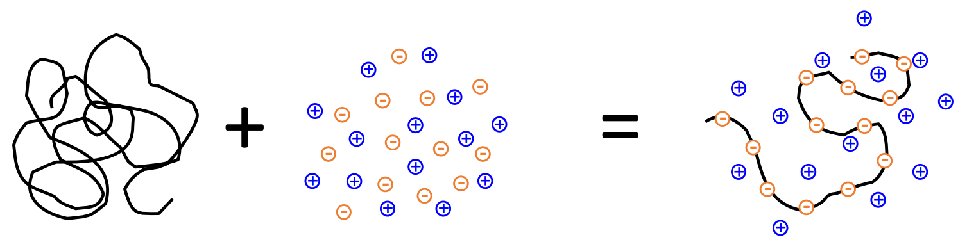
Responsive Hydrogels
Materials that deform under external stimuli
Biopolymer Aqueous Sensorised Hydrogel
Electrolyte (Polyelectrolyte)
Hydrogels are highly flexible, biocompatible, bioresorbable materials.
They are used extensively as scaffold materials in tissue engineering.
[1]
Introduction
Project Goals
Theory
Procedures
Results
Work To Do
Notes:
Many of you will be familiar with hydrogels, they are soft materials that you get when you mix biopolymers with salt solutions. Depending on the type of polymer used, you can get a hydrogel with highly tunable mechanical and rheological properties. They have been used extensively in the emerging field of regenerative medicine, where the polymer network forms a scaffold, acting as a platform for cells to home into and proliferate.

Slide 5
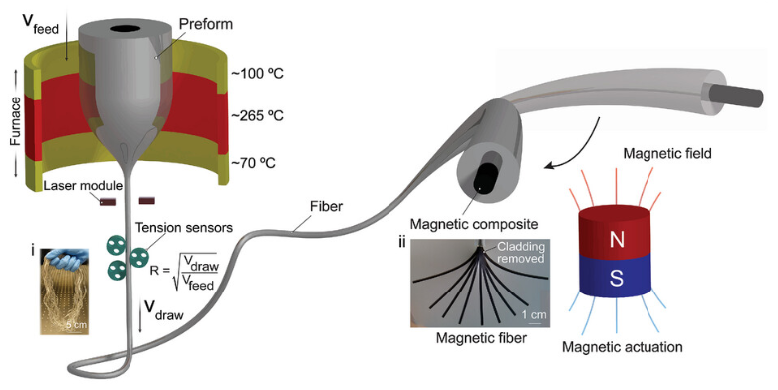
Actuation of Hydrogels
Uses magnetic fibre composites to move the hydrogel remotely
Thin magnetic fibres deform in the presence of an electromagnet.
A hydrogel in contact with the fibres is constrained to move with it.
[2]
Since the stiffness of the fibres is much higher than the stiffness of the hydrogel, the fibres are able to push the hydrogel into a shape that we can control.
Introduction
Project Goals
Theory
Procedures
Results
Work To Do
Notes:
In my project we won’t be doing tissue growth in the body, instead aiming to form model tissues. We need a way to move these tissues ourselves in a way that is biomimetic, and for this we will be using hydrogel composites using magnetic materials. Magnetic fibres embedded within the hydrogel can be deformed by external forces and in turn reshape the hydrogel.

Slide 6
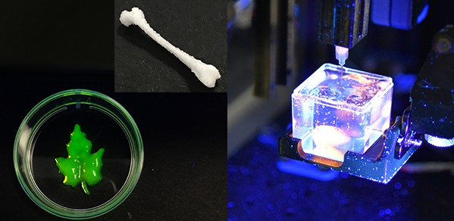
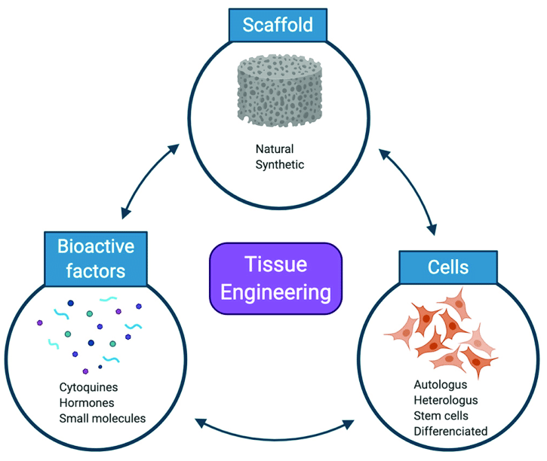
In Vitro Modelling of Organ Tissues
Implants that become part of a person’s natural tissues over time
Application:
In vitro lung models
[3]
Shery’s group has already built a 3D bioprinter (Printer.HM) for extruding soft materials in the Nanoscience centre. [4]
Introduction
Project Goals
Theory
Procedures
Results
Work To Do
Notes:
A good example of putting these ideas together is an in vitro lung model, in which repeated movement of the hydrogel can simulate breathing in and out.

Slide 7
Project Goals
Optimise and synthesise the magnetic fibres
Print and integrate the hydrogel composite
Test mechanical properties of the system
Introduction
Project Goals
Theory
Procedures
Results
Work To Do
‹#›
Notes:
So with that as background I’ll talk about the main goals of the project.

Slide 8


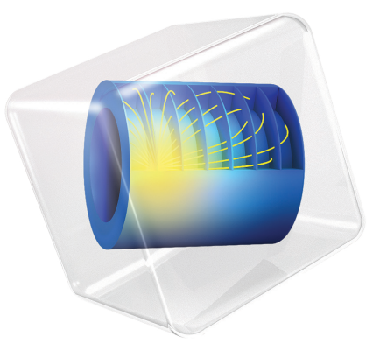

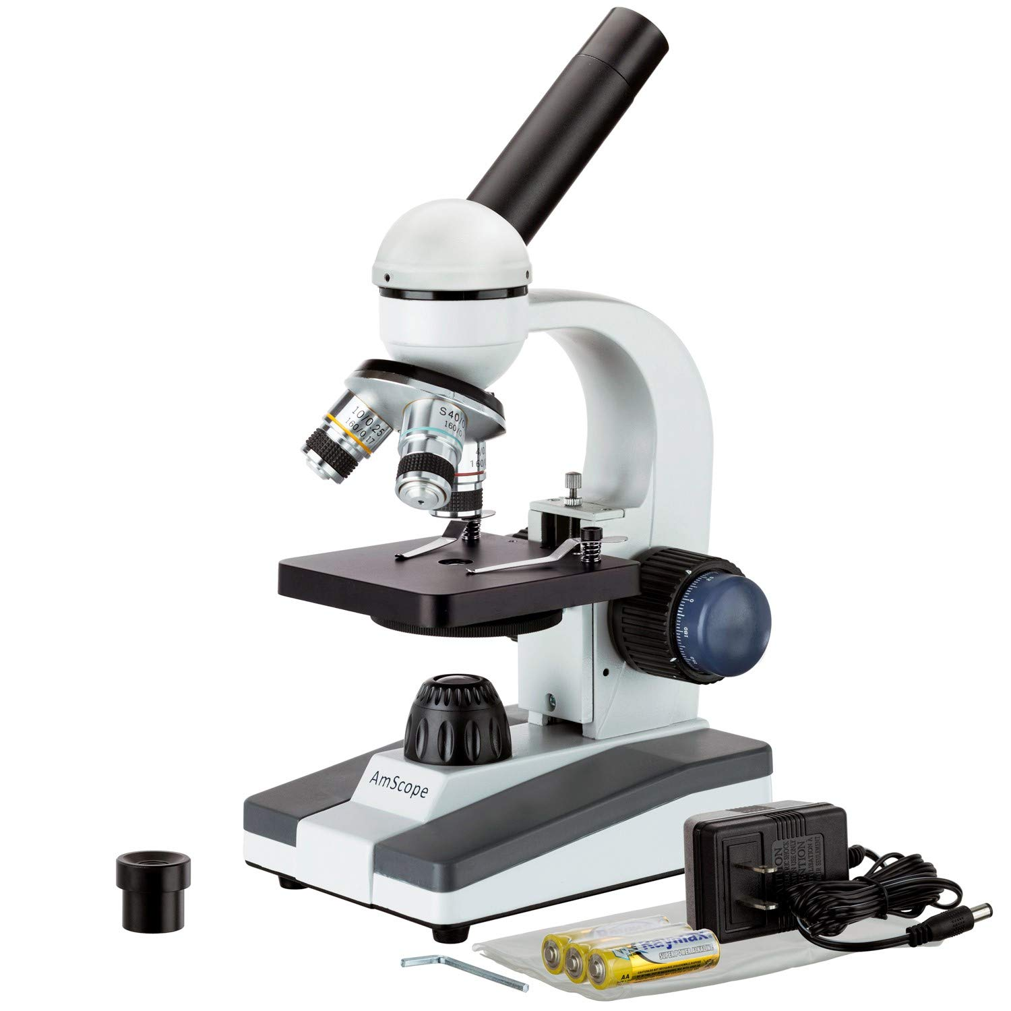
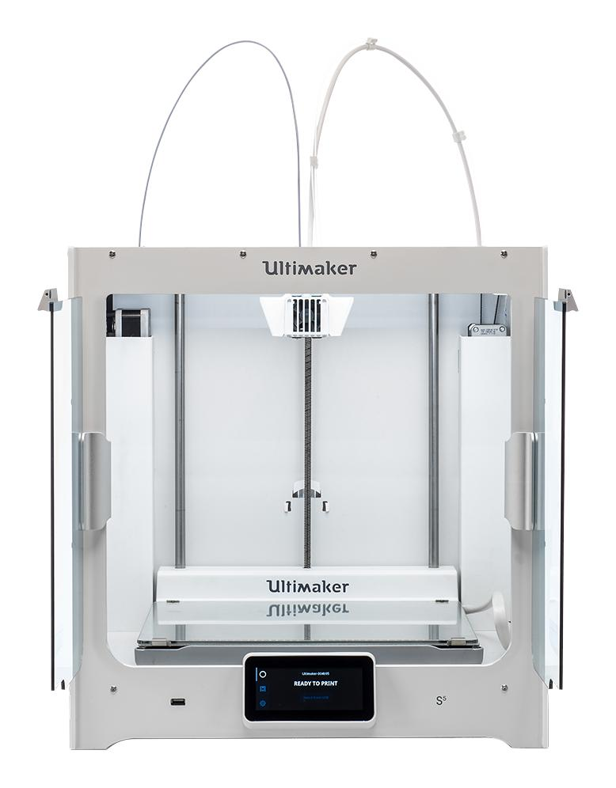
Michaelmas - Magnetic Fibres
Ansys Granta Solidworks Comsol Cura Microscopy 3D Printing
Perform structural analysis, material selection and computational modelling
Make different compositions of magnetic fibres
Aim to find the stiffest material that can deform under a magnetic load
Introduction
Project Goals
Theory
Procedures
Results
Work To Do
Notes:
This term the focus has been on working with the magnetic fibres. The aim is to find the best fibre composition that can deform to a given displacement. By ‘best’, I mean stiffest and most spinnable. Material selection will be done with Ansys Granta, combined with experimental data. Solidworks has been useful in simple 3D modelling, while Comsol can be used for more detailed multiphysics simulations. Cura is for 3D printing and we use microscopes to visualise the fibres and check for consistency.

Slide 9
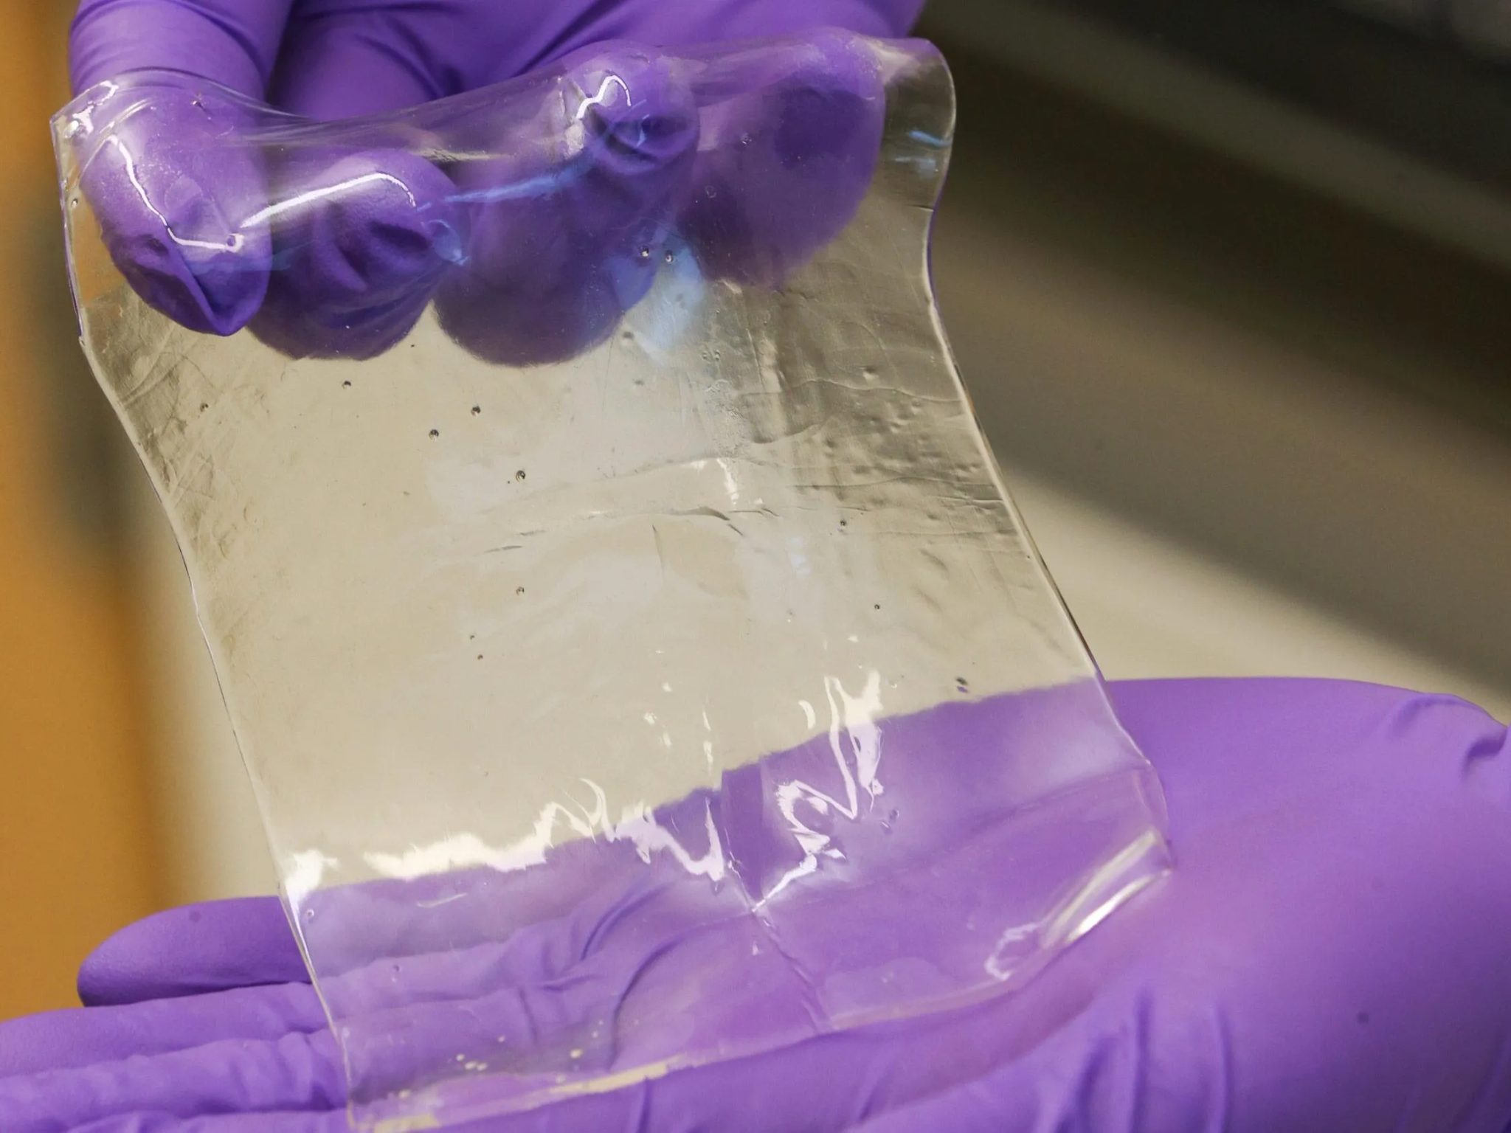
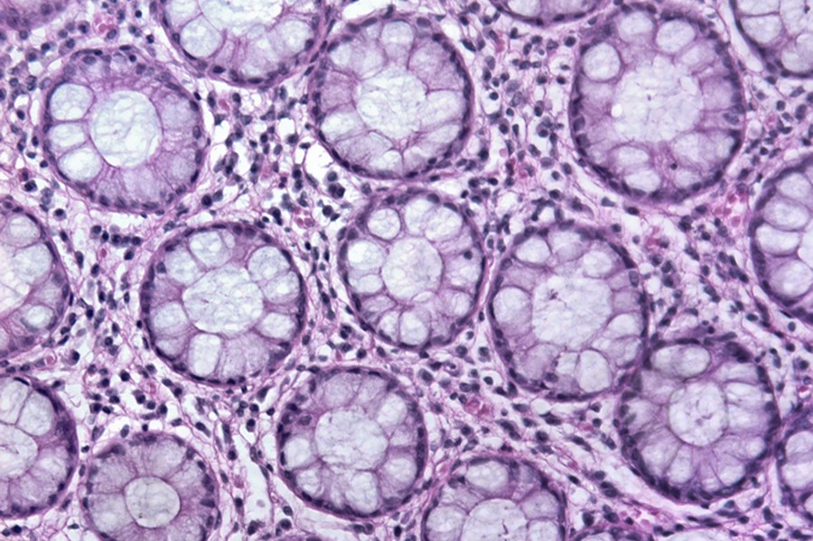
Lent and Easter - Hydrogel Printing
Forming and Testing the Hydrogel Composite
Lent
Synthesise a biocompatible hydrogel
Use Printer.HM to print the hydrogel onto the best magnetic fibres
Measure flexibility of the system with an electromagnet
Easter
Print a model lung tissue seeded with epithelial cell culture
Demonstrate in vitro actuation of the tissue with an electromagnet
Introduction
Project Goals
Theory
Procedures
Results
Work To Do
Notes:
Once the fibres have been selected, I’ll turn to the hydrogels, where we need to choose a suitable gel composition, where we can use the 3D bioprinter to synthesise our hydrogel and combine it with the fibres to get our composite. Thinking towards our end goal of making an in vitro lung model, we can seed the hydrogel with epithelial cells and study their response to the deformation with an electromagnet.

Slide 10
Theory
Simulate the Fibres
Select the Best Materials
Introduction
Project Goals
Theory
Procedures
Results
Work To Do
‹#›
Notes:
Next I’ll talk about some preliminary analysis behind the project.

Slide 11
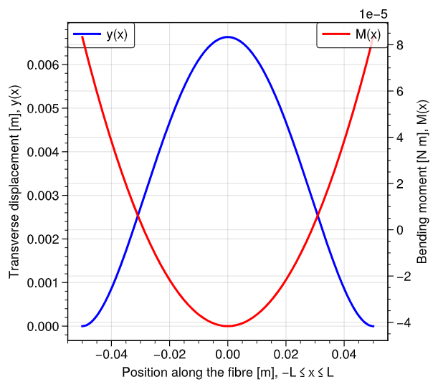
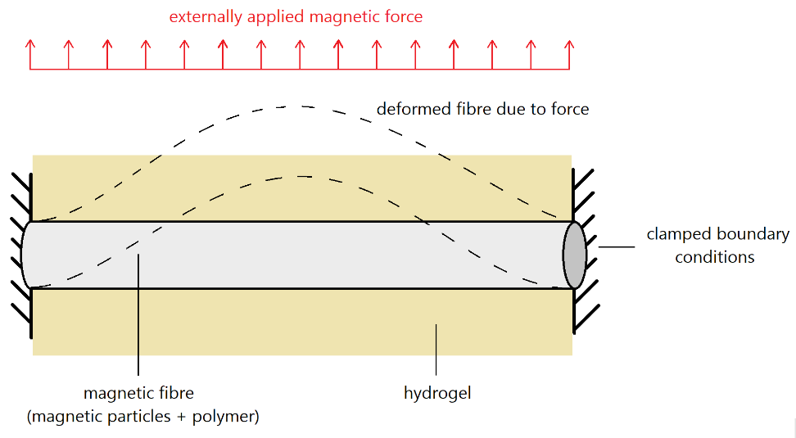
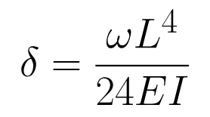
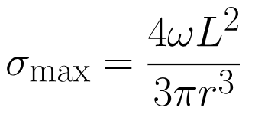
Structural Modelling and Analysis
Setting Up the Model of a Fibre
[5]
Introduction
Project Goals
Theory
Procedures
Results
Work To Do
‹#›
Notes:
This is a structural model of the fibre, with the fibre going across two supports and the hydrogel around it. You can see that this is a simple elastic deformation problem, it’s straightforward to find the maximum displacements and stresses. We can use this information to put upper limits on the material properties of the fibre, such as that the maximum stress must be less than half of the yield stress in order to defend against fatigue failure, and that the strain to failure of the hydrogel is larger than the maximum displacement.

Slide 12
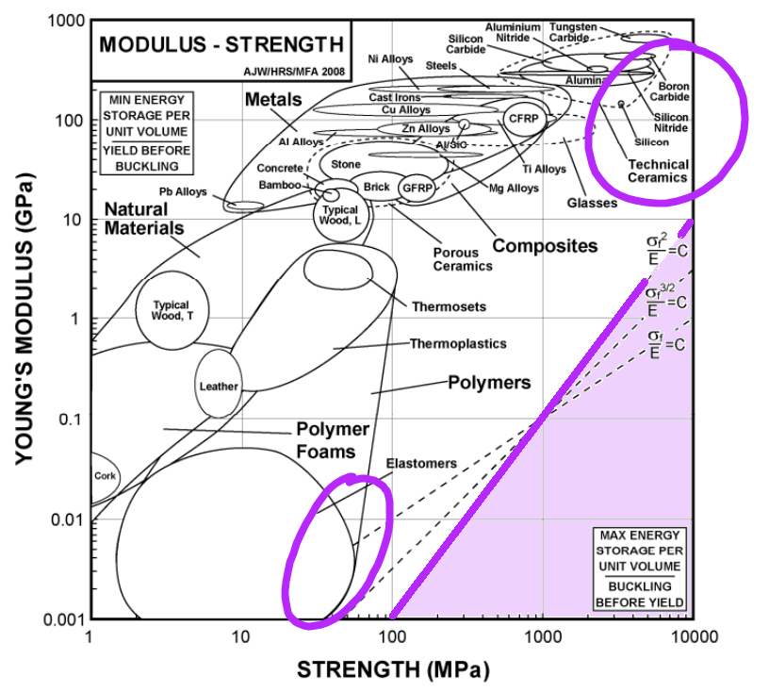
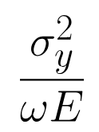
Material Selection
Trade-Offs Between Stiffness and Magnetisation
This is a stiffness-limited design material selection problem.
Performance Index: maximise
σ_{y} [Pa]: fibre yield stress
E [Pa]: fibre Young’s modulus
ω [N m⁻¹]: magnetic force per unit length
[6]
Introduction
Project Goals
Theory
Procedures
Results
Work To Do
‹#›
Notes:
We can construct a performance index for this problem, which turns out to be this expression here, and by visual inspection on the materials property charts you can see that certain types of polymers are going to be suitable for this. We can dive deeper into this data too, checking for biocompatibility of the polymers along the way.

Slide 13
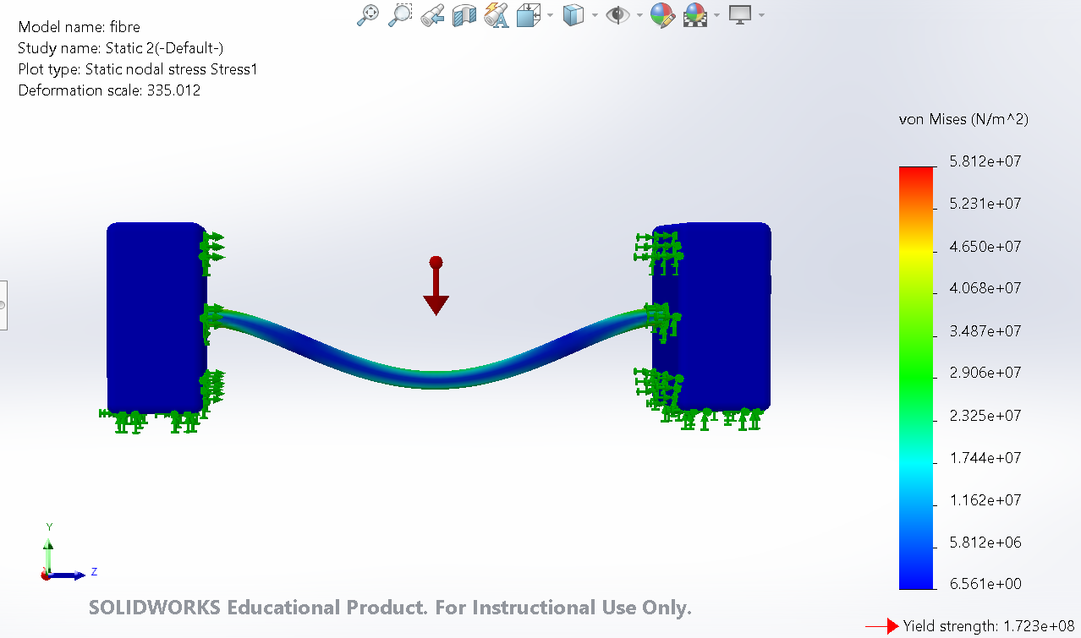
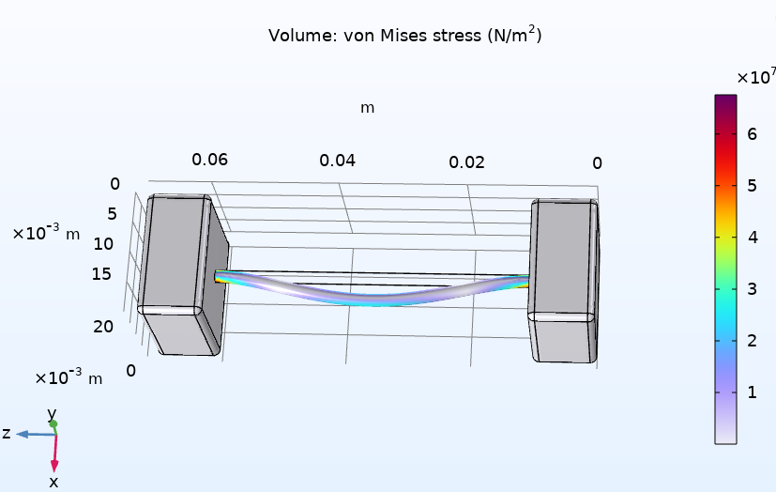
Computational Modelling
Useful for Checking Order-of-Magnitudes of Properties
[7]
[8]
SOLIDWORKS: simple setup
COMSOL Multiphysics: simulation
Introduction
Project Goals
Theory
Procedures
Results
Work To Do
‹#›
Notes:
CAD packages are really useful here, Solidworks offers a simple FEA solver that I’m showing on the left, and Comsol has a more detailed version of this with where you can customise the shape and material parameters to optimise the designs that you’re getting.

Slide 14
Procedures
Make Magnetic Polymer Solution
Program Spinner
Extrude Fibres
Observe Under Microscope
Assess Quality and Deformation
Introduction
Project Goals
Theory
Procedures
Results
Work To Do
‹#›
Notes:
Now some of the practical aspects of the project

Slide 15
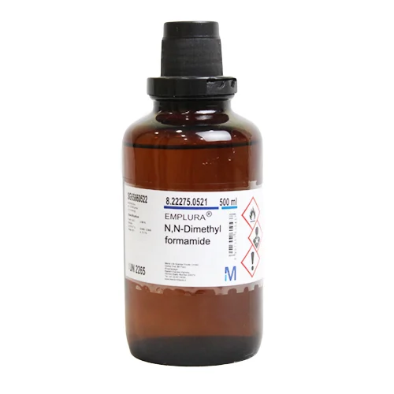
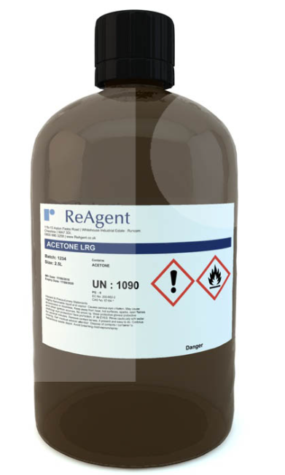
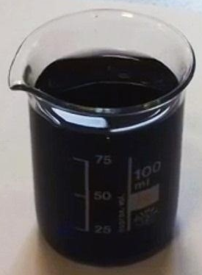
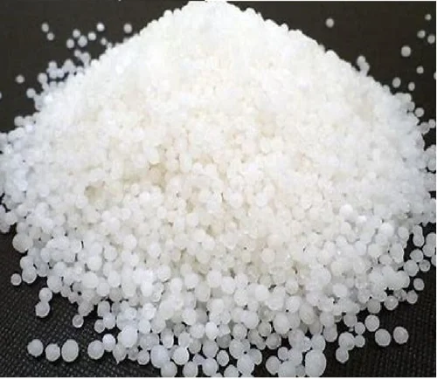
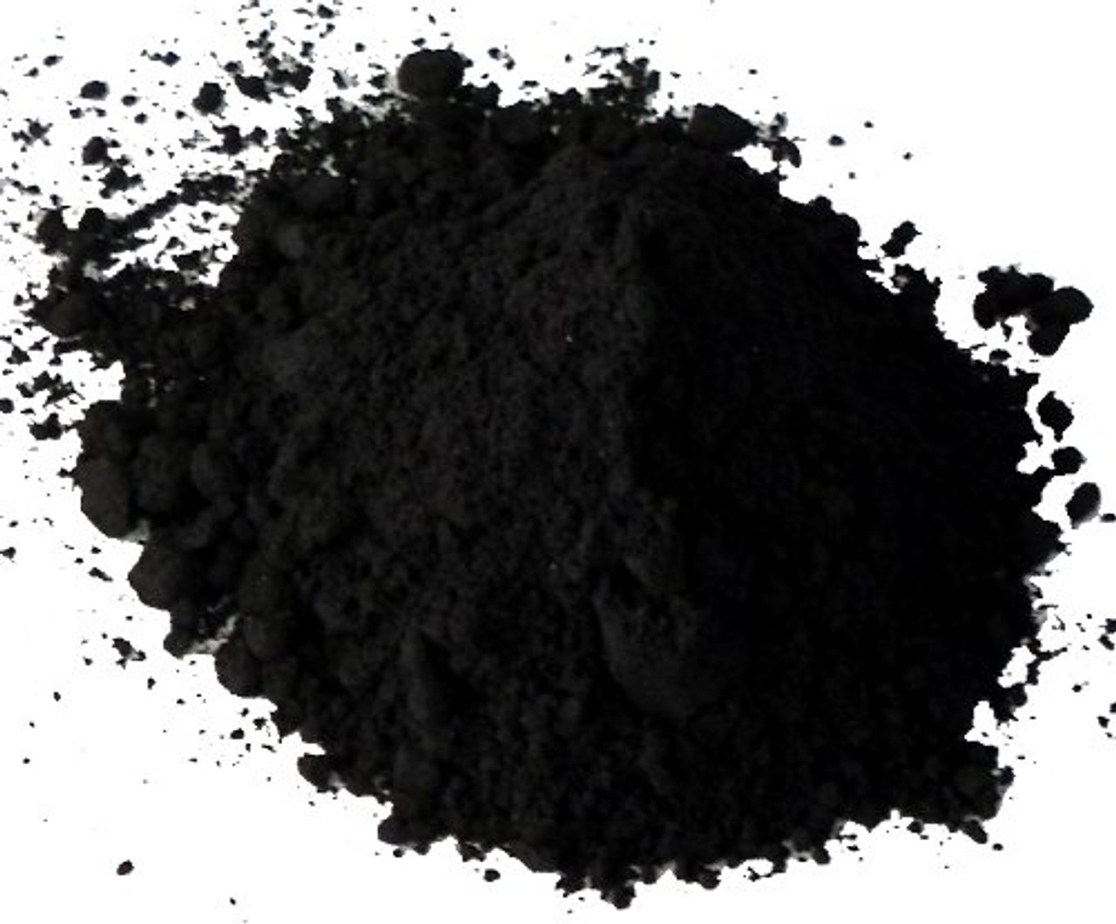

Fibre Composition
Solvent + Polymer + Magnetic Powder → Magnetic Solution
+
+
+
→
Iron oxide
(iron(II, III) oxide)
sets magnetism
Magnetic solution
DMF
(N,N-dimethylformamide)
85% weight
Acetone
(propanone)
15% weight
Polystyrene
sets viscosity
30% weight
Spin-ready
Solvent
Polymer
Magnets
We may also use PEO (high M_{w} PEG) or polyurethane as the polymer.
Introduction
Project Goals
Theory
Procedures
Results
Work To Do
Notes:
So the solution that we made is made from three key parts. The solvent, which creates fluidity, the polymer which sets viscosity and the magnets which provides the magnetic functionality. The choice of polymer so far has been polystyrene which we found works quite well but we also plan to use other biocompatible polymers like polyethylene oxide or polyurethane. But the result of this combination is a magnetic viscous liquid which can be put into a spinning process to produce microscopic fibres.

Slide 16
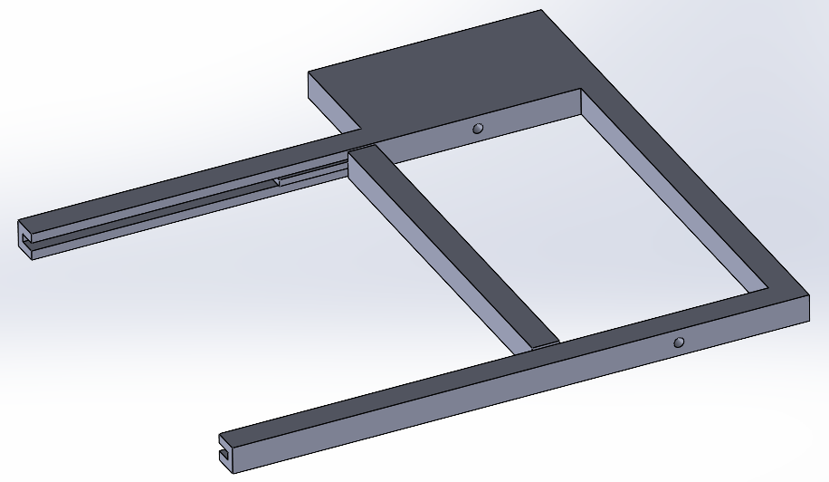
Spinning the Fibres
3D Print a Moveable Frame, Spin with Robot Arm and Pump
[9]
A robotic arm is programmed to hold a syringe containing the magnetic solution
A calibrated pump extrudes the solution through the syringe at a steady rate while the robot arm moves along the frame
An Arduino microcontroller rotates the frame, winding the fibre around the frame
The fibres can then be examined under a light microscope
The deflection under a magnet can be measured with varying iron content
Introduction
Project Goals
Theory
Procedures
Results
Work To Do
Notes:
The spinning process is fairly simple, at first I did it manually by holding a syringe of the fluid over a spinning frame, but we’re currently setting up a robotic arm to automatically pump the fluid out and extrude a steady fibre around the frame. Once we have the frame covered in fibres we can put it under a microscope and see what the fibres look like, and check for consistency and generally assess the quality of the fibres we got.

Slide 17
Results
Suitability of Fibre Solution
Spinnability
Achievable Length Scales
Introduction
Project Goals
Theory
Procedures
Results
Work To Do
‹#›
‹#›
Notes:
Some results we’ve found so far…

Slide 18
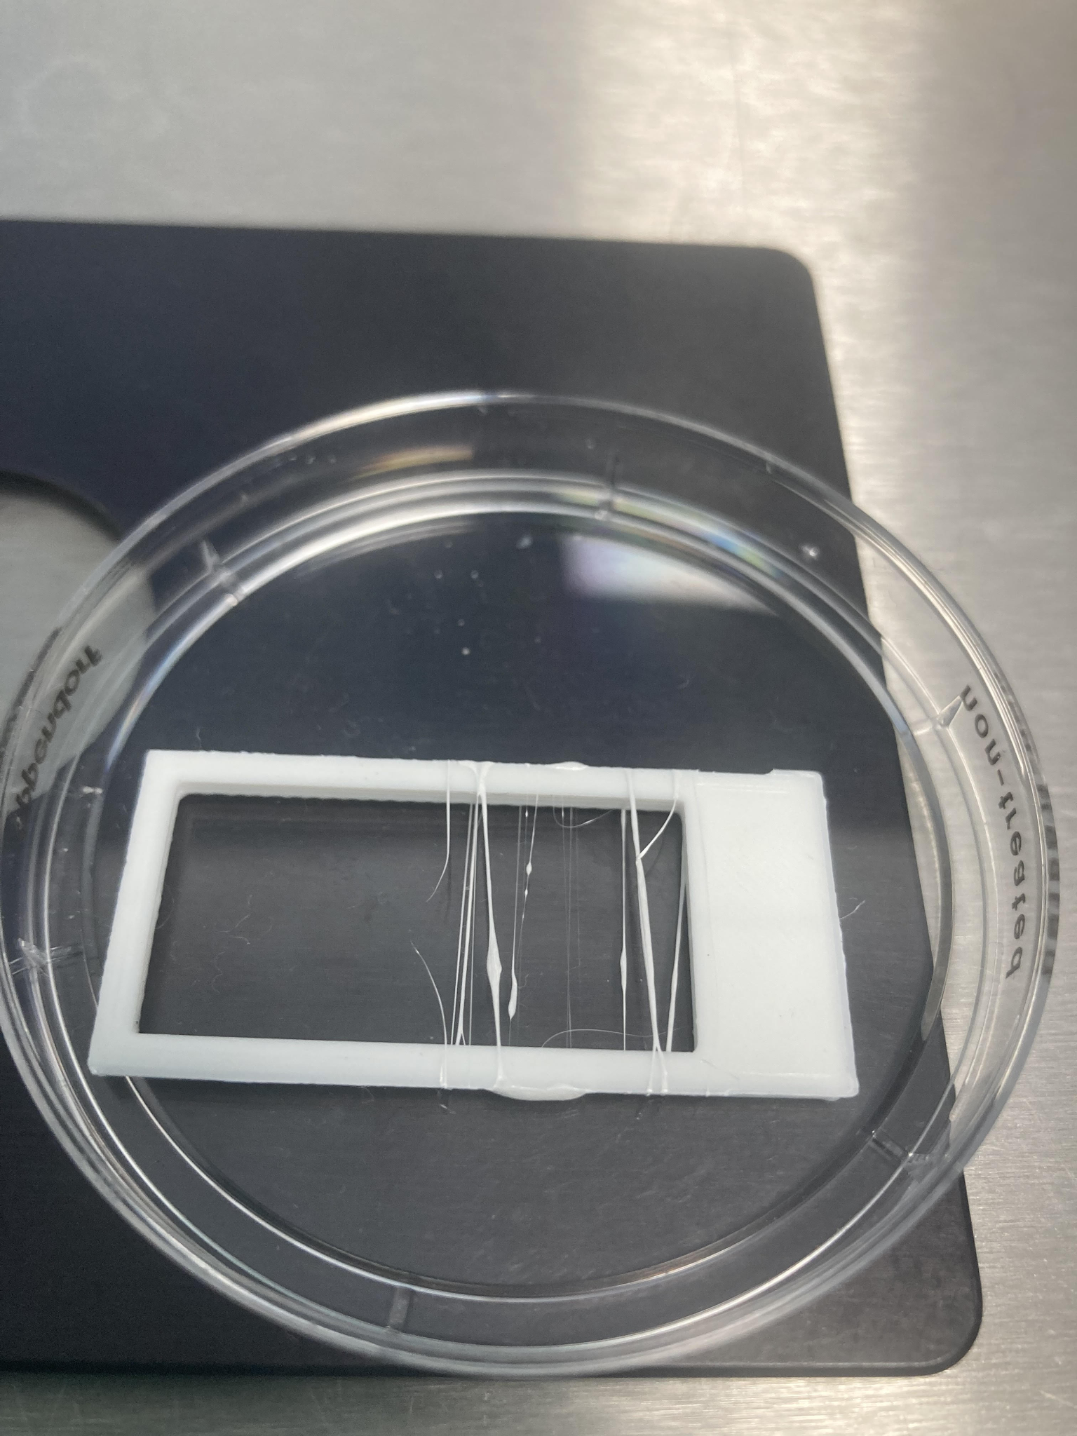
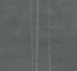
Qualitative Spinnability
Some Compositions Work Better Than Others
Our PEO-based solutions did not produce spinnable solutions.
Using polystyrene gave spinnable fibres in all iron proportions with varying viscosity.
Distance between fibres ~ 1 mm
Thickness of fibres ~ 10+ μm
Introduction
Project Goals
Theory
Procedures
Results
Work To Do
‹#›
Notes:
At first we tried using PEO as the base polymer which didn’t work very well because the sample was degraded, but then we tried polystyrene which gave better spinnability. You can see in the photo the first time I tried spinning it and you can see the fibres are a bit inconsistent in their layout, but if you look closely at a portion of it that spun really well, you can see how thin these fibres are, they’re barely visible in this close-up photo, only a few microns across.

Slide 19
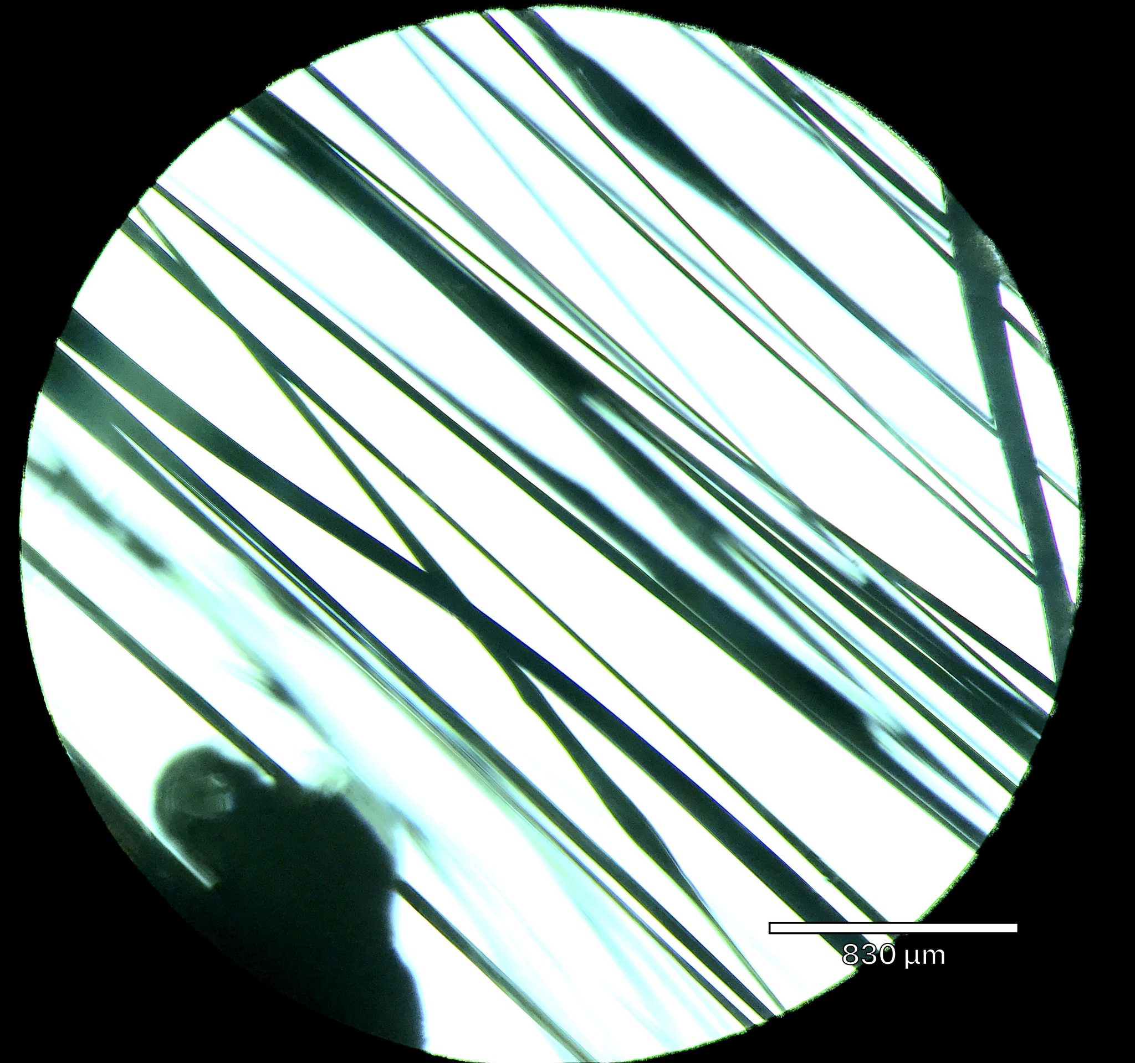
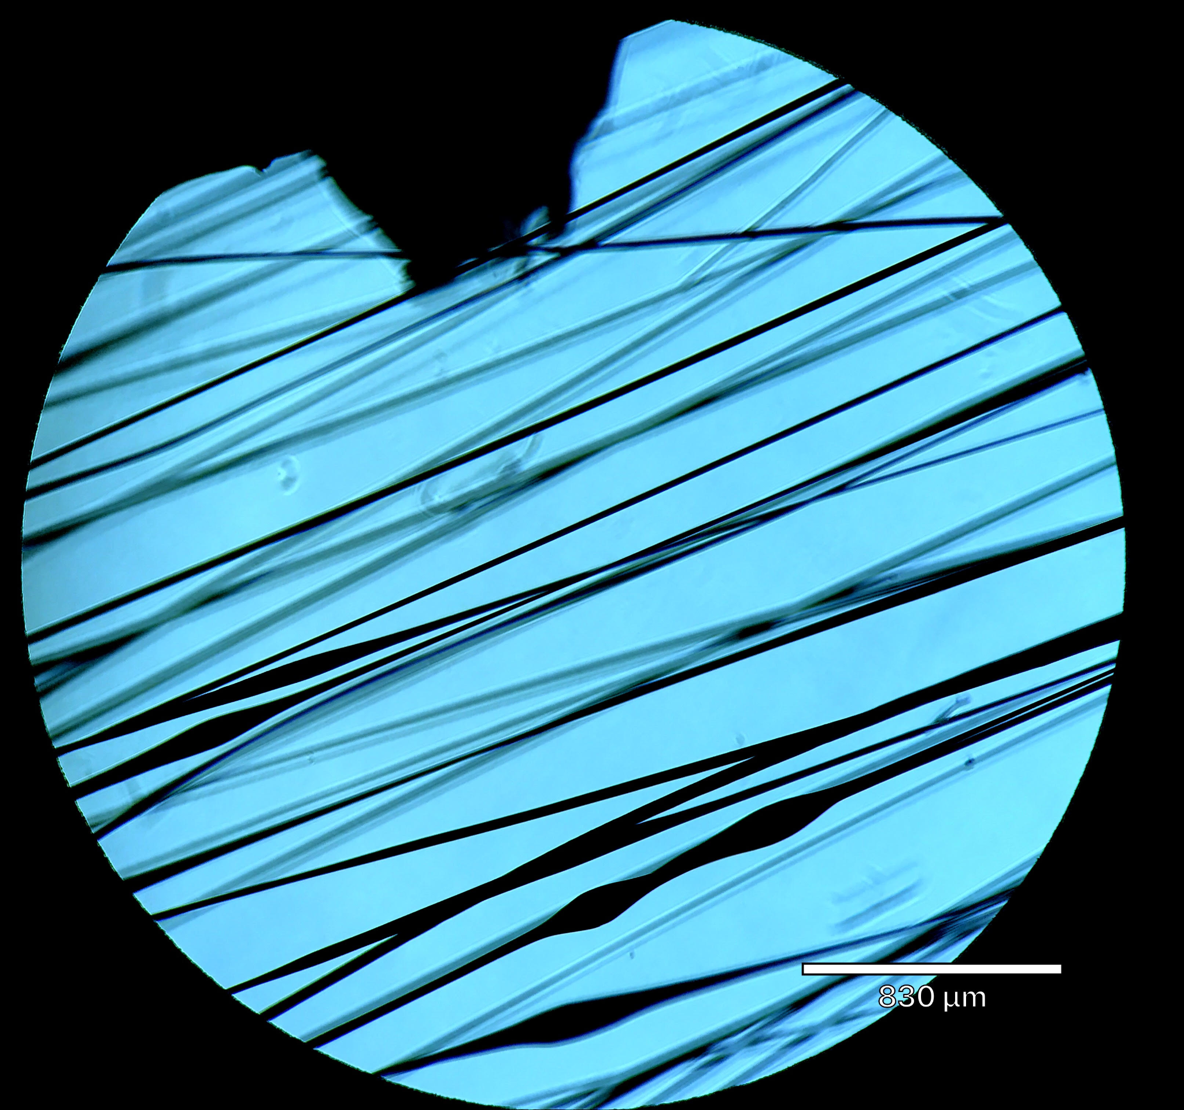
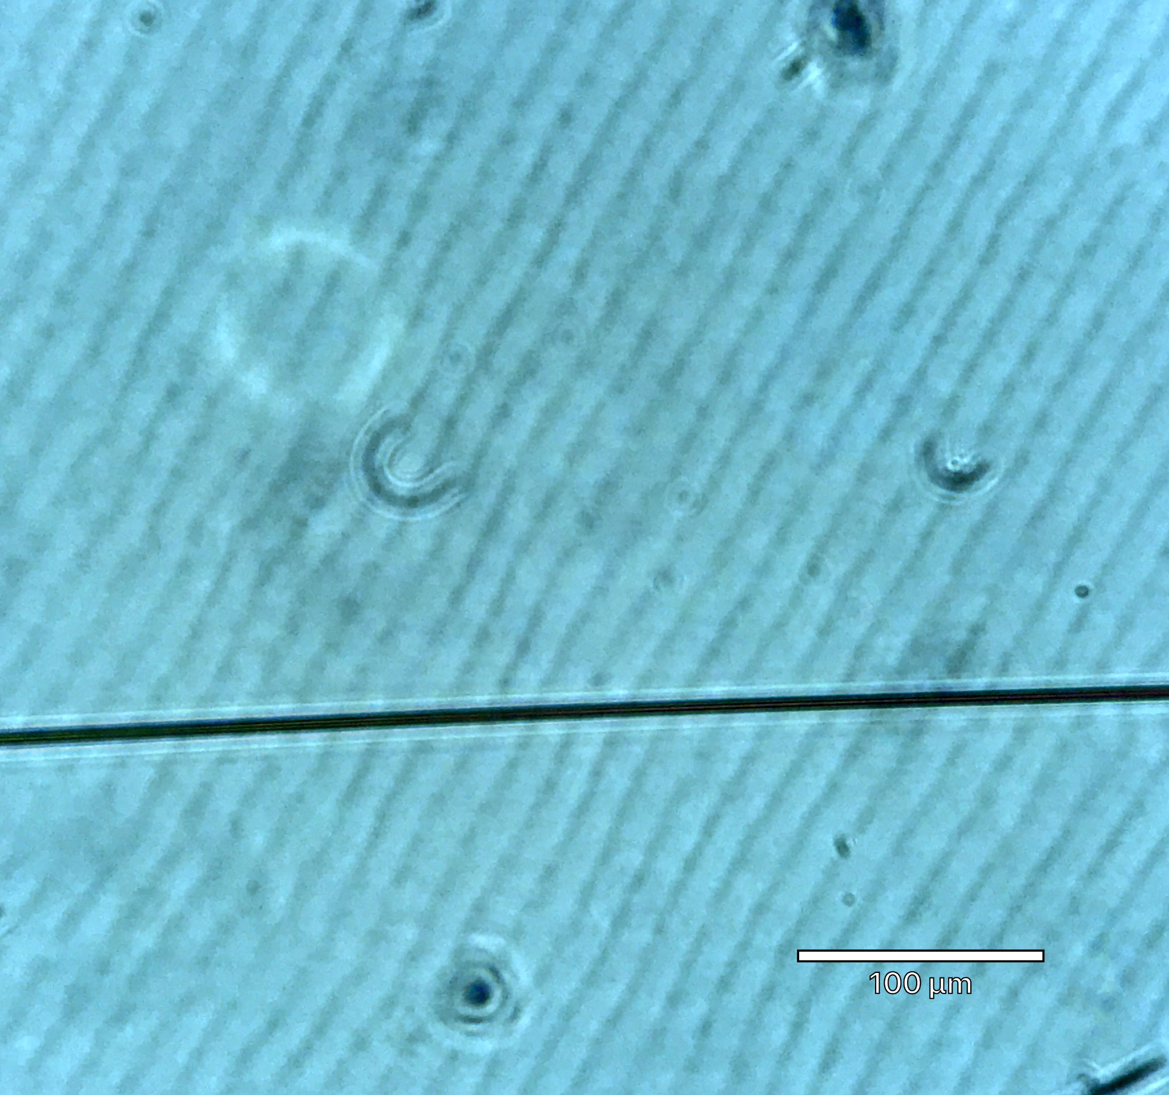
Microscopy
Fibres Should be as Uniform as Possible
Polymer-only fibres
d ~ 50 μm
Magnetic fibres, 30 wt% iron oxide
d ~ 10 μm
Introduction
Project Goals
Theory
Procedures
Results
Work To Do
‹#›
Notes:
Here are some of them under a microscope, after a bit more practice you can get some really good results with these fibres. We found that polystyrene worked well with or without the iron powder and you can get sizes down to about 10 microns.

Slide 20
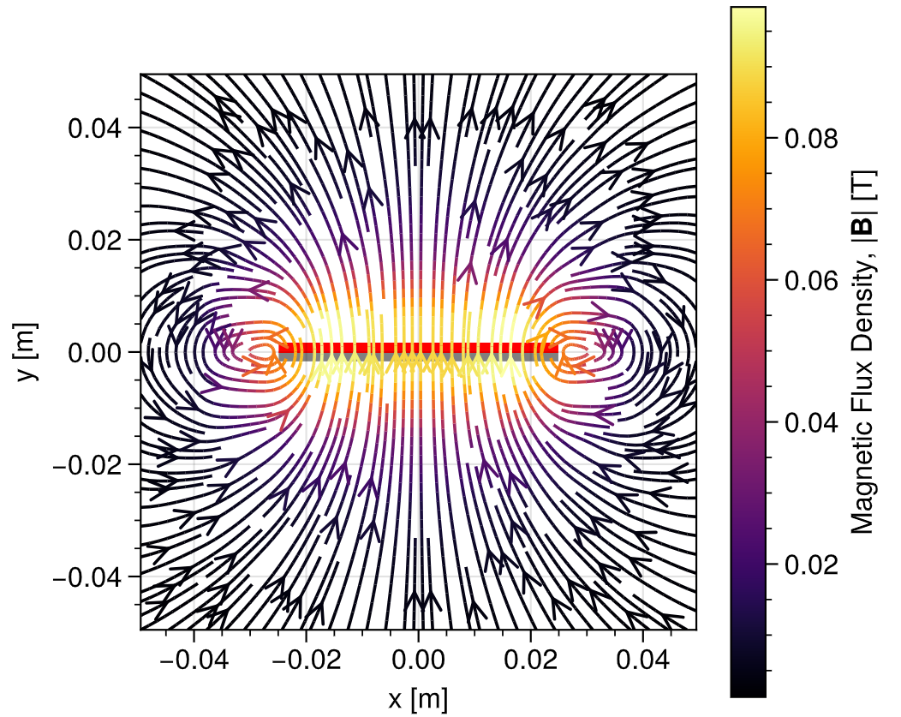
Magnetic Responsiveness
Fibres Should Deflect in a Magnetic Field
[10]
The response to a magnet was difficult to control. It was either too weak to observe or too strong, and the fibres would fall into the magnet, breaking due to their fragility.
These simple tests were performed with a permanent magnet. Going forward, an electromagnet will be used, whose field can be controlled by current input.
Analytic magnetic flux density
around a cuboidal bar magnet
Introduction
Project Goals
Theory
Procedures
Results
Work To Do
‹#›
Notes:
So far we’ve only been able to measure magnetic response using a simple bar ferromagnet, which was quite difficult to control, the fibres would often not respond enough to be visible and then suddenly react too much and be pulled into the magnet. You can see in the simulation on the left representing the field around a bar magnet, the forces increase very rapidly, it’s inversely proportional to the distance^4, and because some of the compositions are so fragile, this can break the fibres. So going forward we’ll use an electromagnet to use a controlled magnetic field to get reproducible and quantitative results.

Slide 21
Work To Do
Finish Building Extrusion Apparatus
Test More Fibre Compositions
Finalise Material Choices
Introduction
Project Goals
Theory
Procedures
Results
Work To Do
‹#›
‹#›
Notes:
Lastly a simple roadmap of what’s to come this term

Slide 22
End of Term Target
The Fibre Composition will be Selected
3D print frames that are easier to move
Set up electromagnet for formal deflection tests
Control pump syringe using Python program
Select materials for optimal fibre composition
Now ~4 lab hours ~4 lab hours ~8 lab hours
(1-2 days) (1-2 days) (2-4 days)
Introduction
Project Goals
Theory
Procedures
Results
Work To Do
‹#›
Notes:
First of all we need to print adjustable frames so that we can better support the fibres, I’ve done this in CAD this weekend just need to print them. Then I’ll calibrate the pump extruder which will automate the spinning process and that’ll be done using python, we already have a good codebase for this system. Then I’ll set up an electromagnet for the deflection tests which I mentioned earlier, and lastly I’ll look at the data, both the qualitative assessments of suitability and the numerical results to select the optimal composition of the fibres.

Slide 23
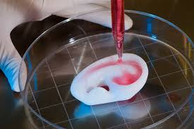
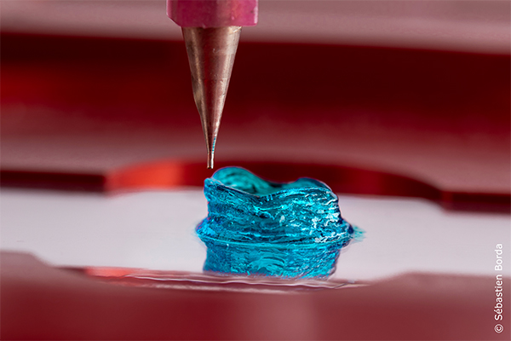
Thank You
Q & A
Sources cited in this presentation
[1] Y. Hong, Z. Lin, Y. Yang, T. Jiang, J. Shang, and Z. Luo, “Biocompatible conductive hydrogels: Applications in the field of biomedicine,” Int. J. Mol. Sci., vol. 23, p. 4578, Apr. 2022
[2] H. Banerjee, A. Leber, S. Laperrousaz, R. La Polla, C. Dong, S. Mansour, X. Wan, and F. Sorin, “Soft multimaterial magnetic fibers and textiles,” Adv. Mater., vol. 35, p. e2212202, Aug. 2023
[3] L. R. Doblado, C. Martinez-Ramos, and M. M. Pradas, “Biomaterials for neural tissue engineering,” Front. Nanotechnol., vol. 3, Apr. 2021.
[4] I. M. Lei, Y. Sheng, C. L. Lei, C. Leow, and Y. Y. S. Huang, “A hackable, multi-functional, and modular extrusion 3D printer for soft materials,” Sci. Rep., vol. 12, p. 12294, July 2022.
Own Content: photographs of experimental results not referenced
[5], [10]: Created in Python. [6]: CUED Materials Databook, CUED. [7], [9]: SOLIDWORKS models. [8]: COMSOL model.
‹#›
‹#›
Notes:
That’s everything, thanks for listening, and we’ll go to questions.

